Slide 1
https://www.youtube.com/watch?v=te5JrSCW-LY&list=PL5-da3qGB5ICCsgW1MxlZ0Hq8LL5U3u9y&index=34
My entire pandas video series: https://www.youtube.com/playlist?list...
Selecting with loc and iloc: https://www.youtube.com/watch?v=xvpNA...
Handling missing values: https://www.youtube.com/watch?v=fCMrO...
Removing rows or columns: https://www.youtube.com/watch?v=gnUKk...
Renaming columns: https://www.youtube.com/watch?v=0uBir...
Using the category data type: https://www.youtube.com/watch?v=wDYDY...
== OTHER RESOURCES ==
Jupyter notebook on GitHub: https://github.com/justmarkham/pandas...
pandas release notes: http://pandas.pydata.org/pandas-docs/...

Slide 2
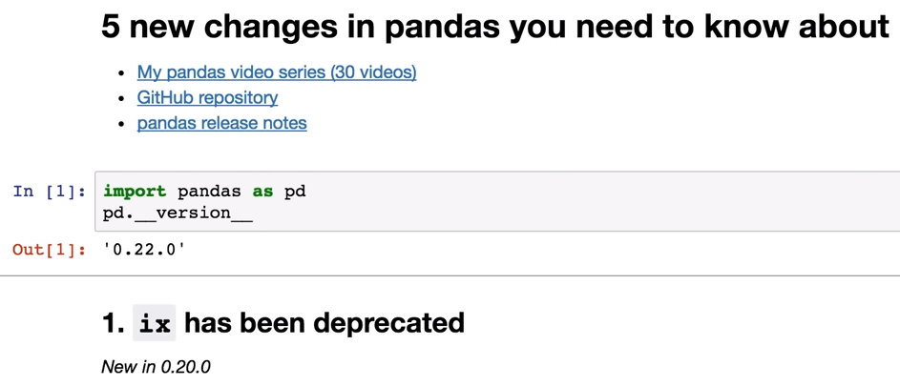
Deprecated : you should stop using this we officially want to stop using this function & in future we probably take this function away & no
longer able to use it & this is the transition period.

Slide 3
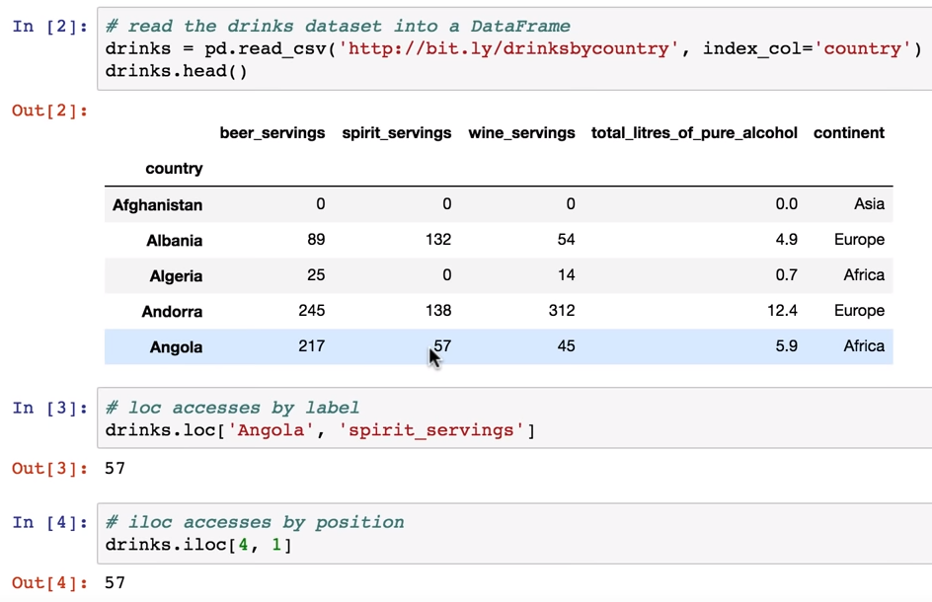
iloc : Integer Location

Slide 4
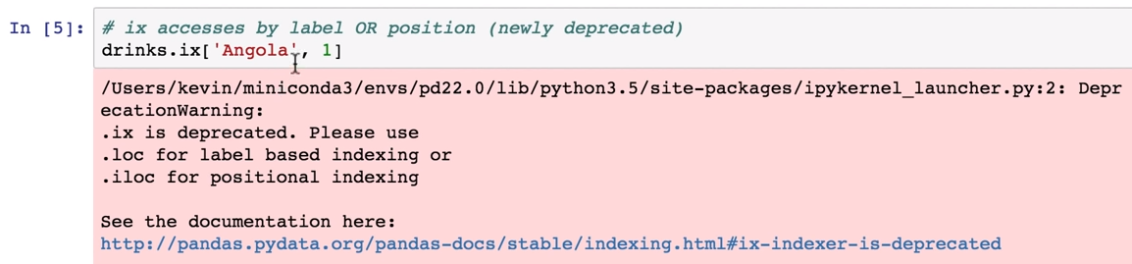

Slide 5
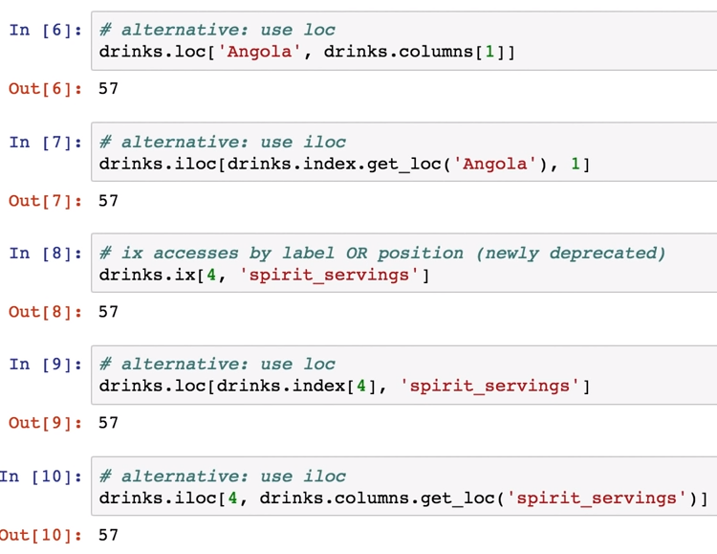

Slide 6
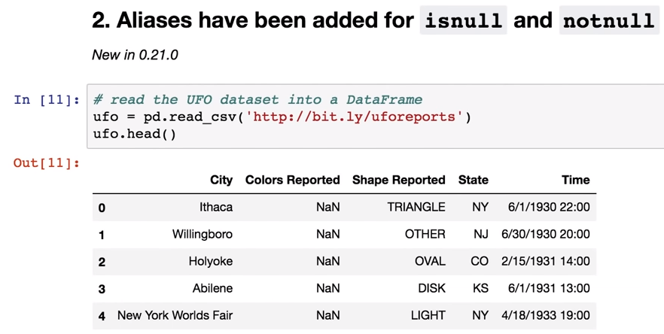

Slide 7
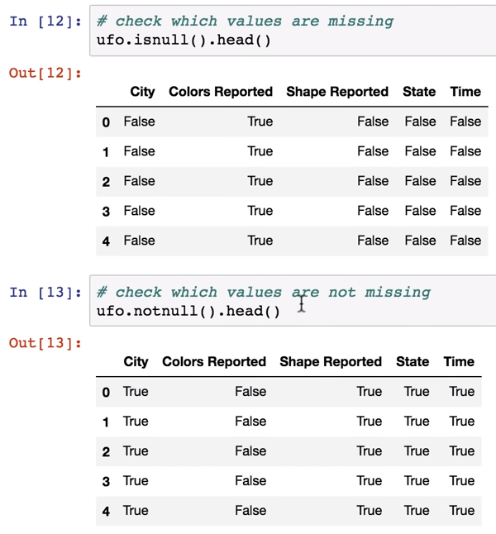

Slide 8
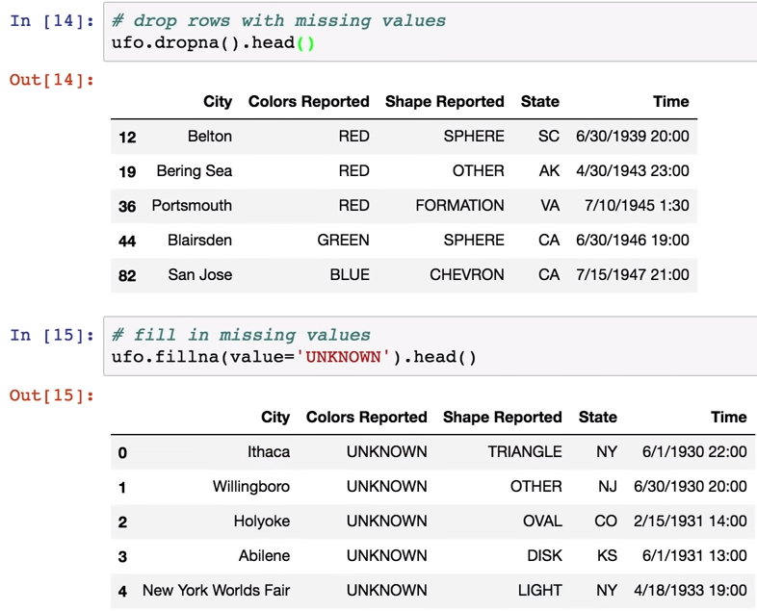

Slide 9
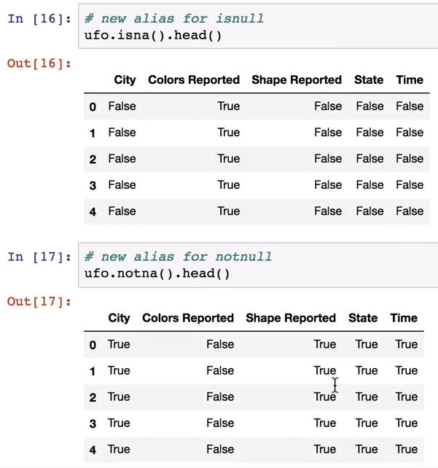
Isnull( ) & notnull( ) : Not yet deprecated but it is
recommended to use isna( ) & notna( )

Slide 10
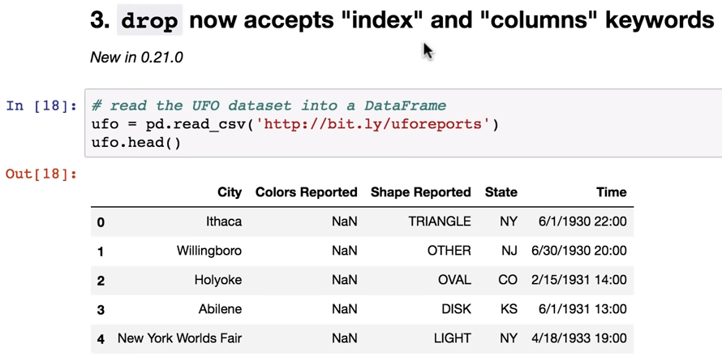

Slide 11
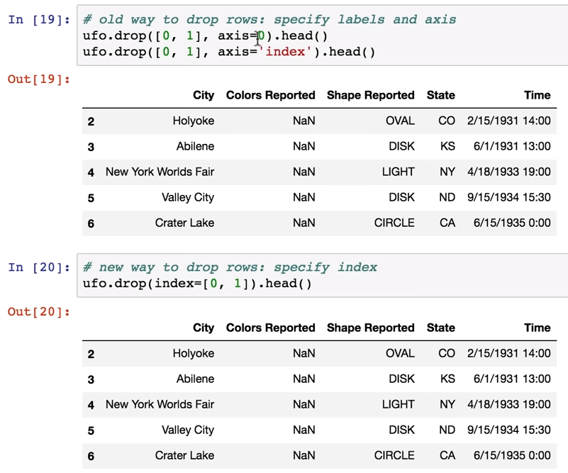

Slide 12
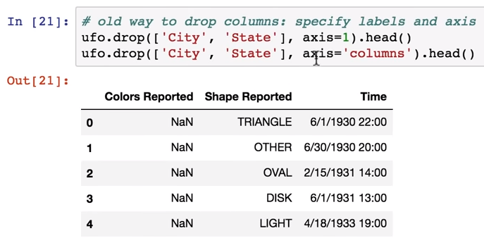
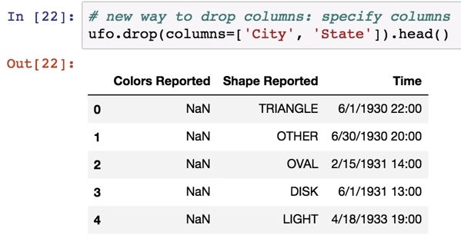

Slide 13
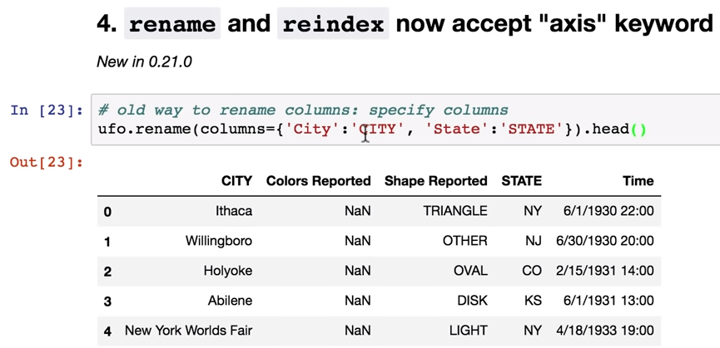
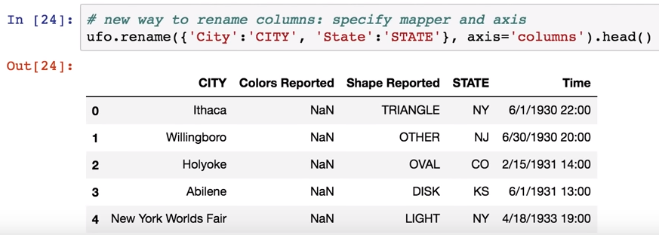

Slide 14
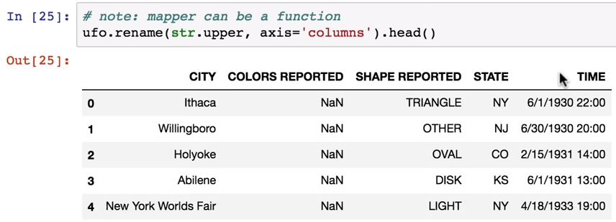

Slide 15
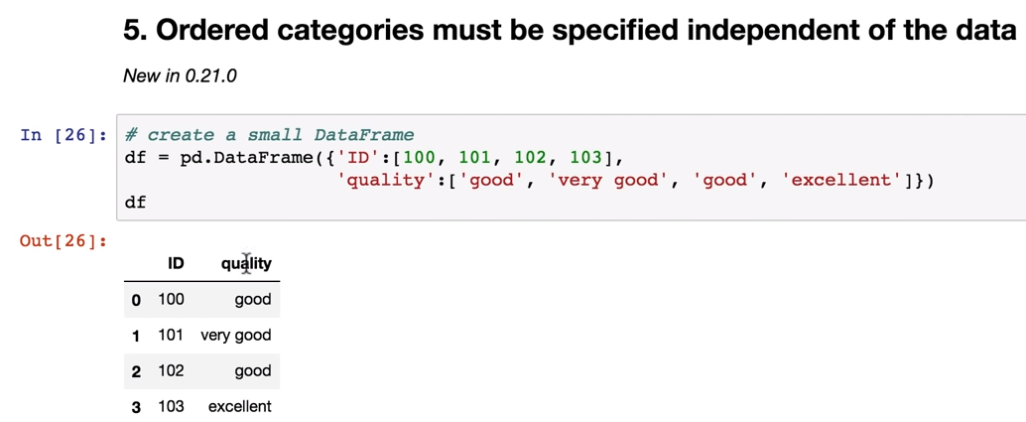

Slide 16
